Slide 1
CSE 225
Graphs

Slide 2
Graphs
A graph is a set of vertices V and a set of edges (u,v) ∈ E where u,v ∈ V
A
B
F
D
E
C
G

Slide 3
Different types of graphs
Undirected – edges do not have a direction
A
B
F
D
E
C
G

Slide 4
Different types of graphs
Directed – edges do have a direction
A
B
F
D
E
C
G

Slide 5
Different types of graphs
Weighted – edges have an associated weight
A
8
7
B
F
2
D
7
1
E
20
2
C
G

Slide 6
Different types of graphs
Weighted – edges have an associated weight
A
8
7
B
F
2
D
7
1
E
20
2
C
G

Slide 7
Terminology
Path – A path is a list of vertices p₁,p₂,…p_{k} where there exists an edge (p_{i},p_{i+1}) ∈ E
A
B
F
D
E
C
G

Slide 8
Terminology
Path – A path is a list of vertices p₁,p₂,…p_{k} where there exists an edge (p_{i},p_{i+1}) ∈ E
{A, B, D, E, F}
A
B
F
D
E
C
G

Slide 9
Terminology
Path – A path is a list of vertices p₁,p₂,…p_{k} where there exists an edge (p_{i},p_{i+1}) ∈ E
{C, D}
A
B
F
D
E
C
G

Slide 10
Terminology
Path – A path is a list of vertices p₁,p₂,…p_{k} where there exists an edge (p_{i},p_{i+1}) ∈ E
A simple path contains no repeated vertices (often this is implied)
A
B
F
D
E
C
G

Slide 11
Terminology
Cycle – A subset of the edges that form a path such that the first and last node are the same
A
B
F
D
E
C
G

Slide 12
Terminology
Cycle – A subset of the edges that form a path such that the first and last node are the same
{A, B, D}
A
B
F
D
E
C
G

Slide 13
Terminology
Cycle – A subset of the edges that form a path such that the first and last node are the same
not a cycle
A
B
F
D
E
C
G

Slide 14
Terminology
Cycle – A subset of the edges that form a path such that the first and last node are the same
A
B
F
D
E
C
G

Slide 15
Terminology
Cycle – A subset of the edges that form a path such that the first and last node are the same
not a cycle
A
B
F
D
E
C
G

Slide 16
Terminology
Cycle – A path p₁,p₂,…p_{k} where p₁ = p_{k}
cycle
A
B
F
D
E
C
G

Slide 17
Terminology
Connected – every pair of vertices is connected by a path
connected
A
B
F
D
E
C
G

Slide 18
Terminology
Connected (undirected graphs) – every pair of vertices is connected by a path
not connected
A
B
F
D
E
C
G

Slide 19
Terminology
Strongly connected (directed graphs) – Every two vertices are reachable by a path
not strongly connected
A
B
F
D
E
C
G

Slide 20
Terminology
Strongly connected (directed graphs) – Every two vertices are reachable by a path
not strongly connected
A
B
F
D
E
G

Slide 21
Terminology
Strongly connected (directed graphs) – Every two vertices are reachable by a path
strongly connected
A
B
F
D
E
G

Slide 22
Different types of graphs
Tree – connected, undirected graph without any cycles
F
A
B
H
D
E
C
G

Slide 23
Different types of graphs
Tree – connected, undirected graph without any cycles
F
A
C
B
H
D
E
need to specify root
G

Slide 24
Different types of graphs
Tree – connected, undirected graph without any cycles
F
A
B
H
D
E
C
G

Slide 25
Different types of graphs
DAG – directed, acyclic graph
F
A
B
H
D
E
C
G

Slide 26
Different types of graphs
Complete graph – an edge exists between every node
A
F
B
D
C

Slide 27
Different types of graphs
Bipartite graph – a graph where every vertex can be partitioned into two sets X and Y such that all edges connect a vertex u ∈ X and a vertex v ∈ Y
A
E
B
F
C
G
D

Slide 28
When do we see graphs in real life problems?
Transportation networks (flights, roads, etc.)
Communication networks
Web
Social networks
Circuit design
Bayesian networks

Slide 29
Representing graphs

Slide 30
Representing graphs
Adjacency list – Each vertex u ∈ V contains an adjacency list of the set of vertices v such that there exists an edge (u,v) ∈ E
A:
B
D
A
B:
A
D
B
C:
D
D
E
D:
A
B
C
E
C
E:
D

Slide 31
Representing graphs
Adjacency list – Each vertex u ∈ V contains an adjacency list of the set of vertices v such that there exists an edge (u,v) ∈ E
A:
B
A
B:
B
C:
D
D
E
D:
A
B
C
E:
D

Slide 32
Representing graphs
Adjacency matrix – A |V|x|V| matrix A such that:
A B C D E
A 0 1 0 1 0 B 1 0 0 1 0 C 0 0 0 1 0 D 1 1 1 0 1 E 0 0 0 1 0
A
B
D
E
C

Slide 33
Representing graphs
Adjacency matrix – A |V|x|V| matrix A such that:
A B C D E
A 0 1 0 1 0 B 1 0 0 1 0 C 0 0 0 1 0 D 1 1 1 0 1 E 0 0 0 1 0
A
B
D
E
C

Slide 34
Representing graphs
Adjacency matrix – A |V|x|V| matrix A such that:
A B C D E
A 0 1 0 1 0 B 1 0 0 1 0 C 0 0 0 1 0 D 1 1 1 0 1 E 0 0 0 1 0
A
B
D
E
C

Slide 35
Representing graphs
Adjacency matrix – A |V|x|V| matrix A such that:
A B C D E
A 0 1 0 1 0 B 1 0 0 1 0 C 0 0 0 1 0 D 1 1 1 0 1 E 0 0 0 1 0
A
B
D
E
C

Slide 36
Representing graphs
Adjacency matrix – A |V|x|V| matrix A such that:
A B C D E
Is it always symmetric?
A 0 1 0 1 0 B 1 0 0 1 0 C 0 0 0 1 0 D 1 1 1 0 1 E 0 0 0 1 0
A
B
D
E
C

Slide 37
Representing graphs
Adjacency matrix – A |V|x|V| matrix A such that:
A B C D E
A 0 1 0 0 0 B 0 0 0 0 0 C 0 0 0 1 0 D 1 1 0 0 0 E 0 0 0 1 0
A
B
D
E
C

Slide 38
Adjacency list vs. adjacency matrix
Adjacency list
Adjacency matrix
Sparse graphs (e.g. web)
Space efficient
Must traverse the adjacency list to discover is an edge exists
Dense graphs
Constant time lookup to discover if an edge exists
simple to implement
for non-weighted graphs, only requires boolean matrix

Slide 39
Weighted graphs
Adjacency list
store the weight as an additional field in the list
A:
B:8
D:3
A
8
3
B
D
13
2
E
10
C

Slide 40
Weighted graphs
Adjacency matrix
A B C D E
A 0 8 0 3 0 B 8 0 0 2 0 C 0 0 0 10 0 D 3 2 10 0 13 E 0 0 0 13 0
A
8
3
B
D
13
2
E
10
C

Slide 41
Graph algorithms/questions
Graph traversal (BFS, DFS)
Shortest path from a to b
unweighted
weighted positive weights
negative/positive weights
Minimum spanning trees
Are all nodes in the graph connected?
Is the graph bipartite?

Slide 42
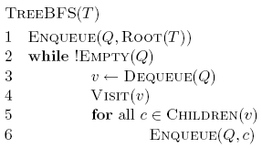
Breadth First Search (BFS) on Trees

Slide 43
Tree BFS
A
B
D
E
C
F
G
Q:

Slide 44
Tree BFS
A
B
D
E
C
F
G
Q: A

Slide 45
Tree BFS
A
B
D
E
C
F
G
Q:

Slide 46
Tree BFS
A
B
D
E
C
F
G
Q: B, D, E

Slide 47
Tree BFS
A
B
D
E
C
F
G
Q: D, E

Slide 48
Tree BFS
A
B
D
E
C
F
G
Q: D, E, C, F

Slide 49
Tree BFS
A
B
D
E
C
F
G
Q: E, C, F

Slide 50
Tree BFS
A
B
D
E
C
F
G
Q: E, C, F
Frontier: the set of vertices that have been visited so far

Slide 51
Tree BFS
A
B
D
E
C
F
G

Slide 52
Tree BFS
A
B
D
E
C
F
G

Slide 53
Tree BFS
A
B
D
E
C
F
G

Slide 54
Tree BFS
A
B
D
E
C
F
G

Slide 55
Tree BFS
What order does the algorithm traverse the nodes?
BFS traversal visits the nodes in increasing distance from the root

Slide 56
Tree BFS
Does it visit all of the nodes?

Slide 57
Running time of Tree BFS
Adjacency list
How many times does it visit each vertex?
How many times is each edge traversed?
O(|V|+|E|)
Adjacency matrix
For each vertex visited, how much work is done?
O(|V|²)

Slide 58
BFS Recursively
Hard to do!

Slide 59
BFS for graphs
What needs to change for graphs?
Need to make sure we don’t visit a node multiple times
C
A
B
F
G
D
E

Slide 60
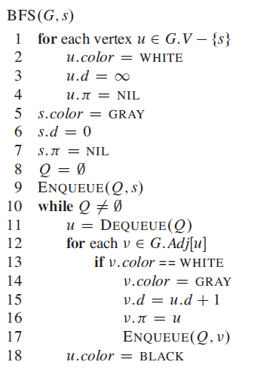
distance variable keeps track of how far from the starting
C
A
B
F
G
D
E

Slide 61
set all nodes except s as unseen
C
A
B
F
G
D
E

Slide 62
check if the node has been seen
C
A
B
F
G
D
E

Slide 63
set the node as seen and record distance
C
A
B
F
G
D
E

Slide 64
Q: A
∞
C
0
∞
A
B
∞
∞
F
G
∞
∞
D
E

Slide 65
Q:
∞
C
0
∞
A
B
∞
∞
F
G
∞
∞
D
E

Slide 66
Q: D, E, B
∞
C
0
1
A
B
∞
∞
F
G
1
1
D
E

Slide 67
Q: E, B
∞
C
0
1
A
B
∞
∞
F
G
1
1
D
E

Slide 68
Q: B
∞
C
0
1
A
B
∞
∞
F
G
1
1
D
E

Slide 69
Q: B
∞
C
0
1
A
B
∞
∞
F
G
1
1
D
E

Slide 70
Q:
∞
C
0
1
A
B
∞
∞
F
G
1
1
D
E

Slide 71
Q:
∞
C
0
1
A
B
∞
∞
F
G
1
1
D
E

Slide 72
Q: F, C
2
C
0
1
A
B
2
∞
F
G
1
1
D
E

Slide 73
Q: C, G
2
C
0
1
A
B
2
3
F
G
1
1
D
E

Slide 74
Q: G
2
C
0
1
A
B
2
3
F
G
1
1
D
E

Slide 75
2
C
0
1
A
B
2
3
F
G
1
1
D
E

Slide 76
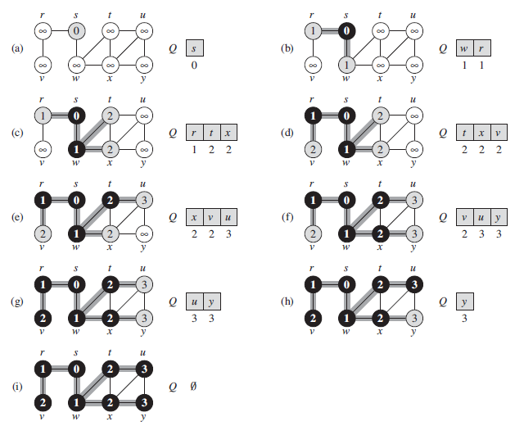
Another Example

Slide 77
Runtime of BFS
Adjacency list: O(|V| + |E|)
Adjacency matrix: O(|V|²)

Slide 78
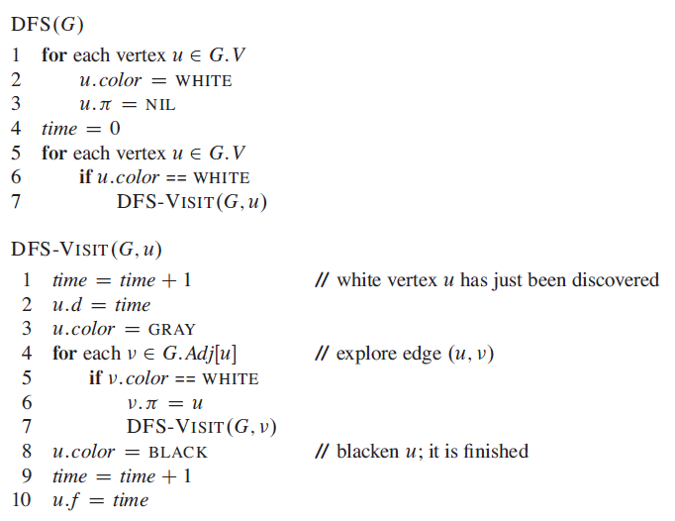
Depth First Search (DFS)

Slide 79
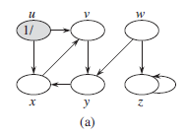
Working Mechanism (1/2)

Slide 80
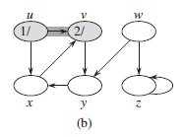
Working Mechanism (2/2)

Slide 81
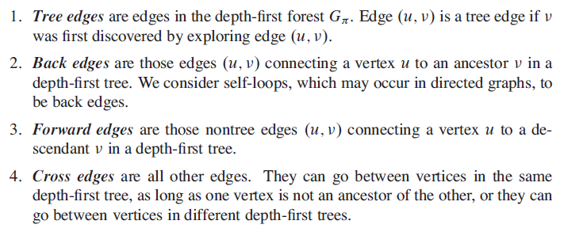
Classification of Edges

Slide 82
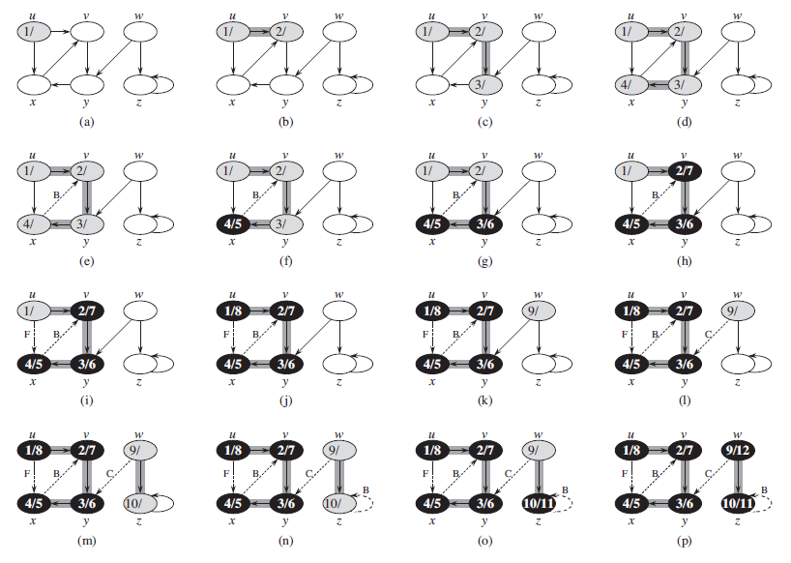

Slide 83
What does DFS do?
Finds connected components
Each call to DFS-Visit from DFS starts exploring a new set of connected components
Helps us understand the structure/connectedness of a graph

Slide 84
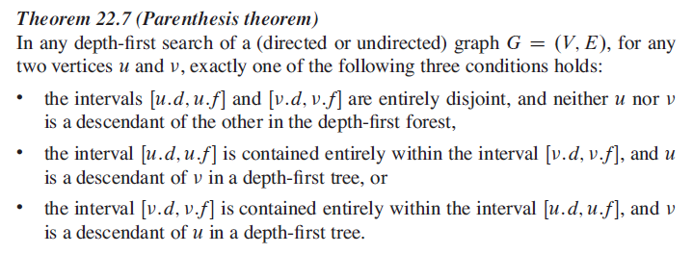
Parenthesis Structure

Slide 85
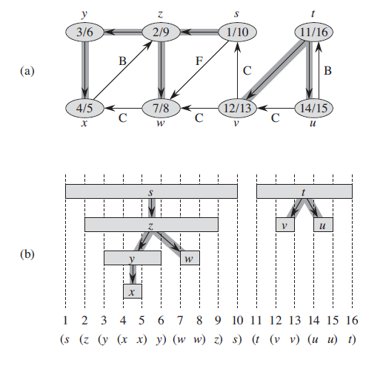

Slide 86
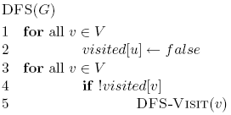
Is DFS correct?
Does DFS visit all of the nodes in a graph?

Slide 87
Running time?
Like BFS
Visits each node exactly once
Processes each edge exactly twice (for an undirected graph)
O(|V|+|E|)

